Slide 1
Distributed systems and Cloud Computing
Lecture 5

Slide 2
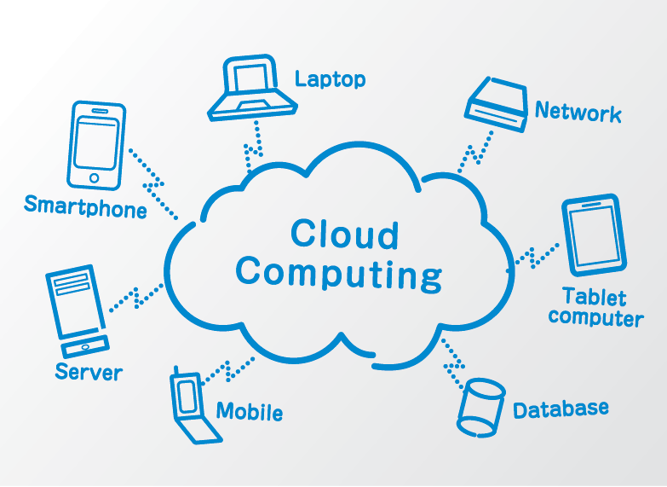

Slide 3
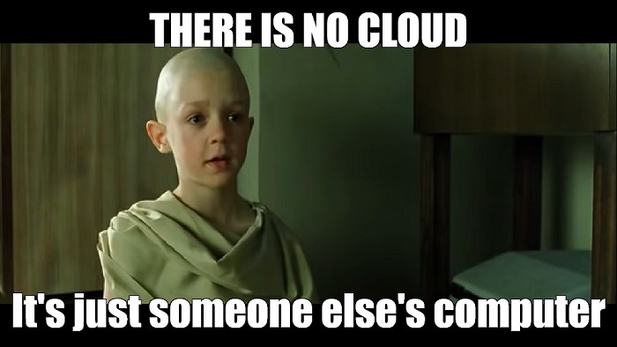

Slide 4
What is cloud computing?
Cloud computing is the on-demand access of computing resources—physical servers or virtual servers, data storage, networking capabilities, application development tools, software, AI-powered analytic tools and more—over the internet with pay-per-use pricing.

Slide 5
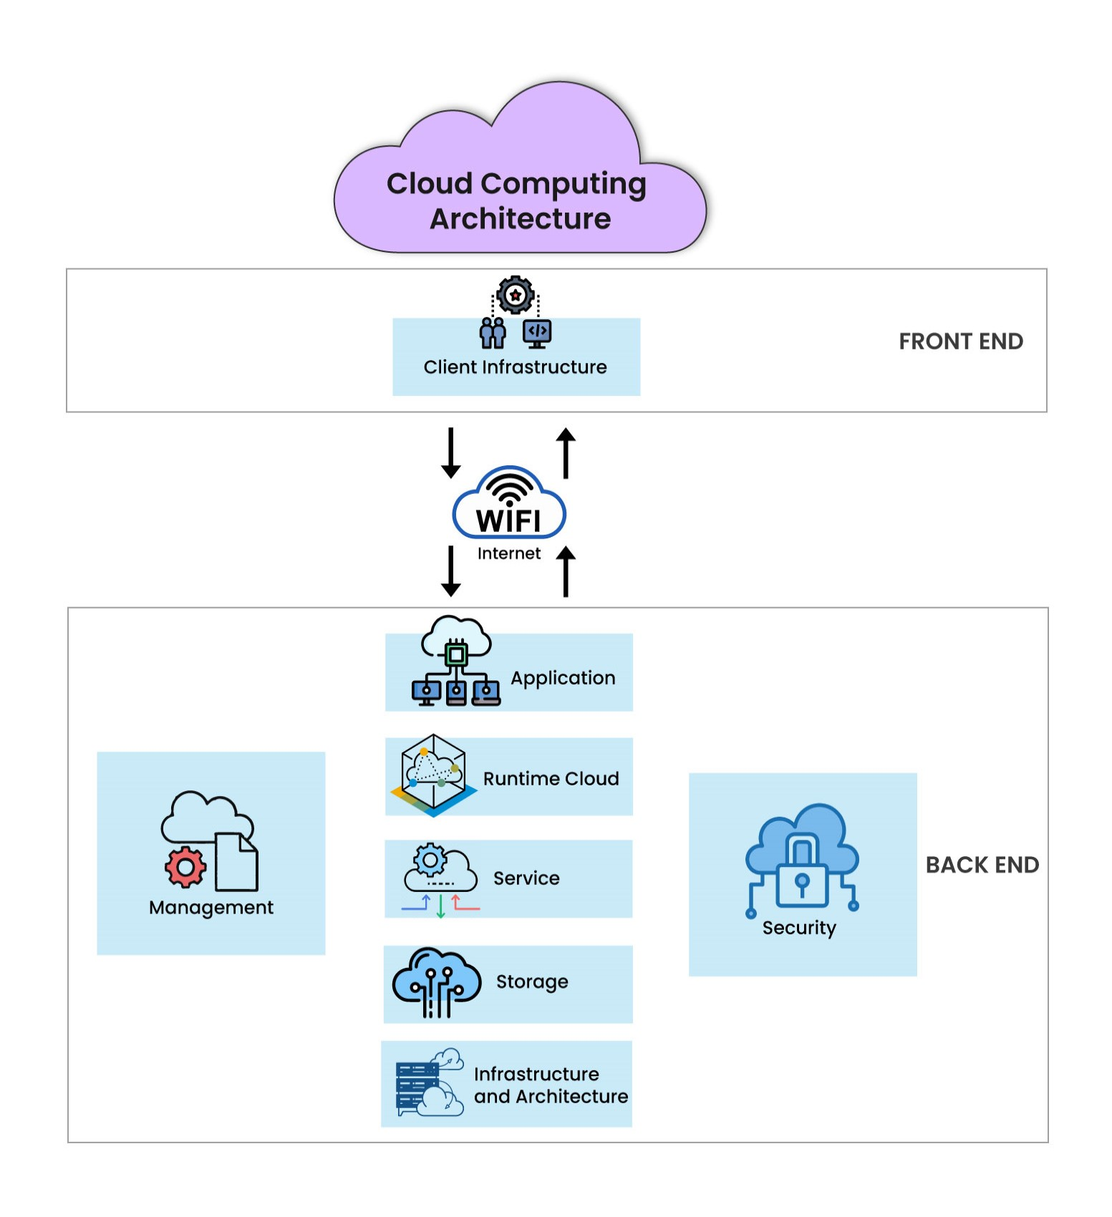

Slide 6
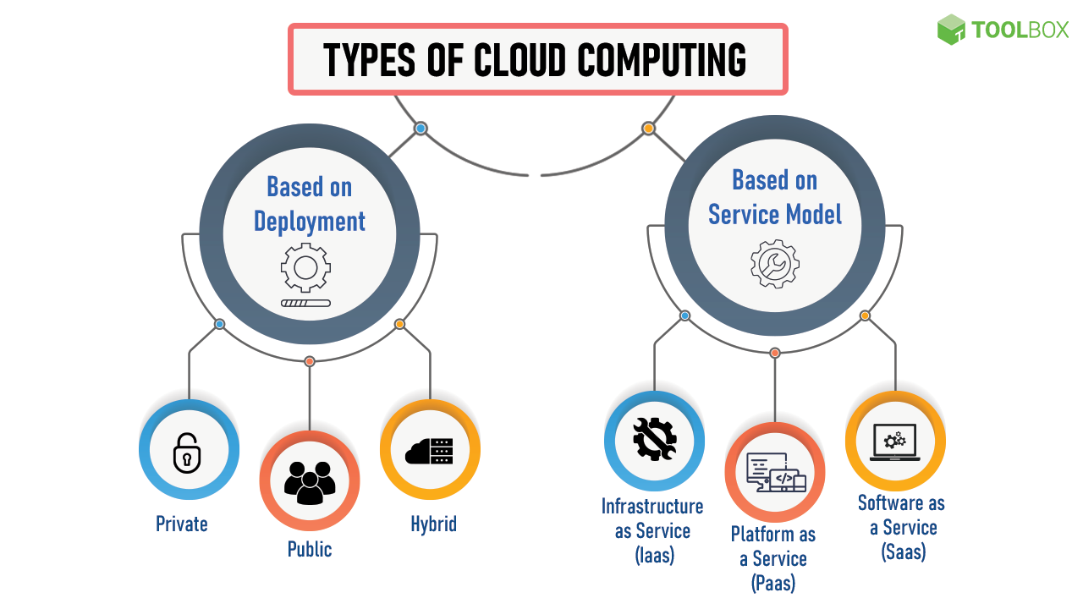

Slide 7
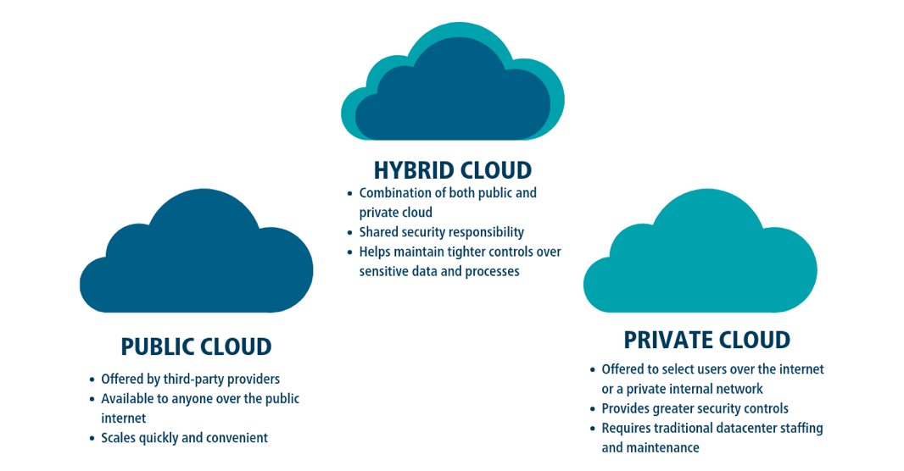

Slide 8
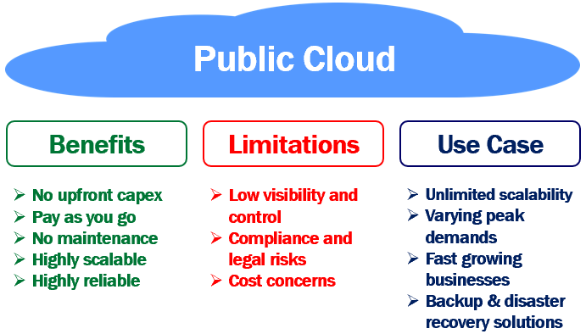

Slide 9
Public Cloud
Public Cloud provides a shared platform that is accessible to the general public through an Internet connection.
Public cloud operated on the pay-as-per-use model and administered by the third party, i.e., Cloud service provider.
In the Public cloud, the same storage is being used by multiple users at the same time.
Public cloud is owned, managed, and operated by businesses, universities, government organizations, or a combination of them.

Slide 10
Private Cloud
Private cloud is also known as an internal cloud or corporate cloud.
Private cloud provides computing services to a private internal network (within the organization) and selected users instead of the general public.
Private cloud provides a high level of security and privacy to data through firewalls and internal hosting. It also ensures that operational and sensitive data are not accessible to third-party providers.

Slide 11
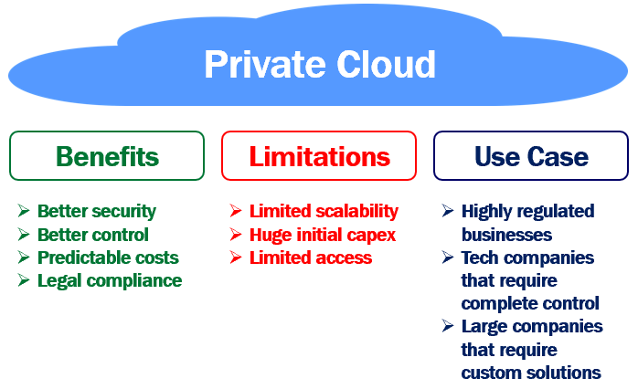

Slide 12
Hybrid Cloud
Hybrid cloud is a combination of public and private clouds.
Hybrid cloud = public cloud + private cloud
The main aim to combine these cloud (Public and Private) is to create a unified, automated, and well-managed computing environment.
In the Hybrid cloud, non-critical activities are performed by the public cloud and critical activities are performed by the private cloud.
Mainly, a hybrid cloud is used in finance, healthcare, and Universities.

Slide 13
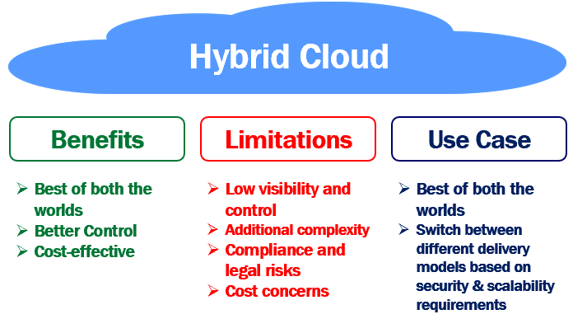

Slide 14
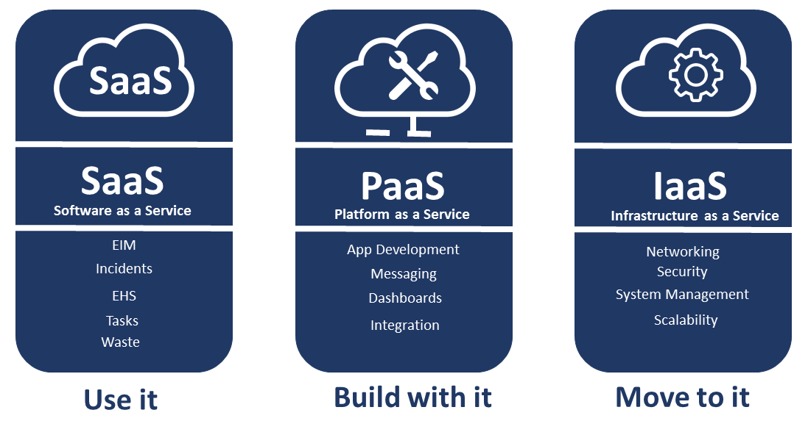
Cloud Service Models

Slide 15
Infrastructure as a Service (IaaS)
IaaS is also known as Hardware as a Service (HaaS). It is a computing infrastructure managed over the internet. The main advantage of using IaaS is that it helps users to avoid the cost and complexity of purchasing and managing the physical servers.
Characteristics of IaaS
Resources are available as a service
Services are highly scalable
Dynamic and flexible
GUI and API-based access
Automated administrative tasks

Slide 16
Platform as a Service (PaaS)
PaaS cloud computing platform is created for the programmer to develop, test, run, and manage the applications.
Characteristics of PaaS
Accessible to various users via the same development application.
Integrates with web services and databases.
Builds on virtualization technology, so resources can easily be scaled up or down as per the organization's need.
Support multiple languages and frameworks.
Provides an ability to "Auto-scale".

Slide 17
Software as a Service (SaaS)
SaaS is also known as "on-demand software". It is a software in which the applications are hosted by a cloud service provider. Users can access these applications with the help of internet connection and web browser.
Characteristics of SaaS
Managed from a central location
Hosted on a remote server
Accessible over the internet
Users are not responsible for hardware and software updates. Updates are applied automatically.
The services are purchased on the pay-as-per-use basis

Slide 18
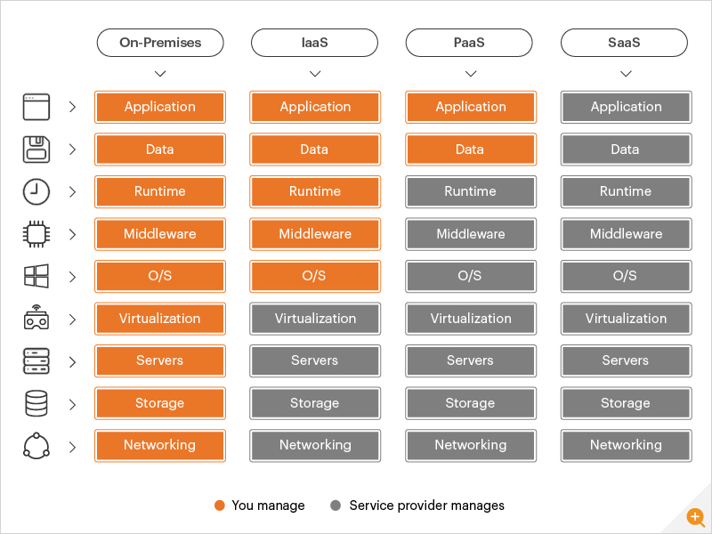

Slide 19
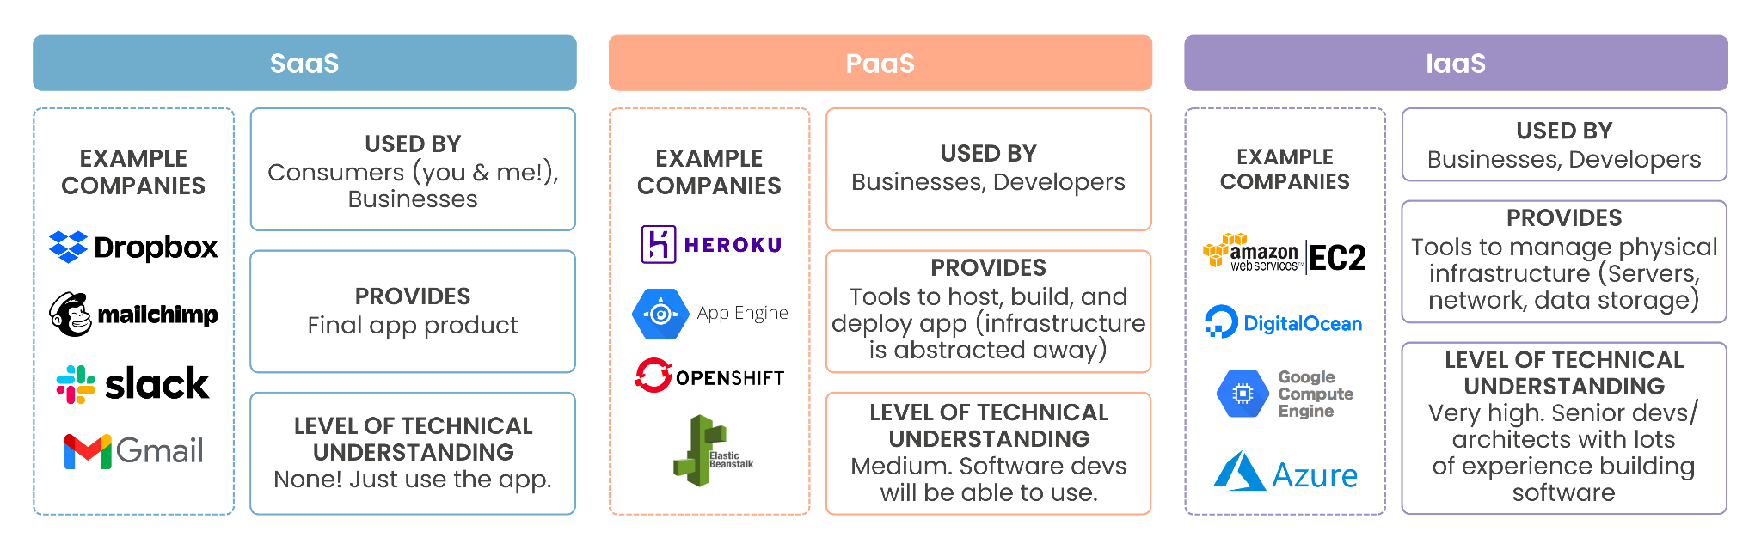

Slide 20
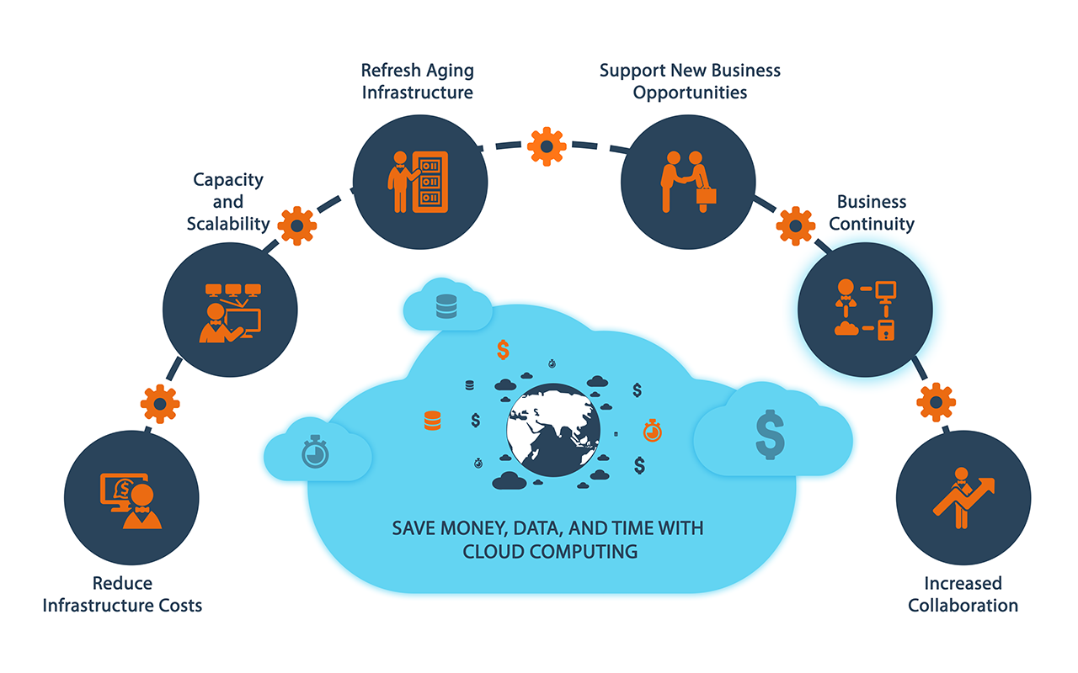

Slide 21
Advantages of Cloud Computing
Backup and restore data
Once the data is stored in the cloud, it is easier to get back-up and restore that data using the cloud.
Improved collaboration
Cloud applications improve collaboration by allowing groups of people to quickly and easily share information in the cloud via shared storage.
Excellent accessibility
Cloud allows us to quickly and easily access store information anywhere, anytime in the whole world, using an internet connection. An internet cloud infrastructure increases organization productivity and efficiency by ensuring that our data is always accessible.
Low maintenance cost
Cloud computing reduces both hardware and software maintenance costs for organizations.

Slide 22
Advantages of Cloud Computing
Mobility
Cloud computing allows us to easily access all cloud data via mobile.
IServices in the pay-per-use model
Cloud computing offers Application Programming Interfaces (APIs) to the users for access services on the cloud and pays the charges as per the usage of service.
Unlimited storage capacity
Cloud offers us a huge amount of storing capacity for storing our important data such as documents, images, audio, video, etc. in one place.
Data security
Data security is one of the biggest advantages of cloud computing. Cloud offers many advanced features related to security and ensures that data is securely stored and handled.

Slide 23
Disadvantages of Cloud Computing
Internet Connectivity
If you do not have good internet connectivity, you cannot access data. However, we have no any other way to access data from the cloud.
Vendor lock-in
Organizations may face problems when transferring their services from one vendor to another. As different vendors provide different platforms, that can cause difficulty moving from one cloud to another.
Limited Control
Infrastructure is completely owned, managed, and monitored by the service provider. Users have less control over the function and execution of services within a cloud infrastructure.
Security
Before adopting cloud technology, you should be aware that you will be sending all your organization's sensitive information to a third party, i.e., a cloud computing service provider. While sending the data on the cloud, there may be a chance that your organization's information is hacked by Hackers.

Slide 24
How cloud computing can help your organization
If your organization experiences any of the following, you’re probably a good candidate for cloud computing:
High business growth that outpaces infrastructure capabilities
Low utilization of existing infrastructure resources
Large volumes of data that are overwhelming your on-premises data storage resources
Slow response times with on-premises infrastructure
Delayed product development cycles due to infrastructure constraints
Cash flow challenges due to high computing infrastructure expenses
Highly mobile or distributed user population

Slide 25
Cloud security
Shared responsibility for security
The cloud service provider is responsible for securing cloud infrastructure, and the customer is responsible for protecting its data within the cloud.
Data encryption
Data should be encrypted
Security and compliance monitoring
Understanding all regulatory compliance standards applicable to your industry
Collaborative management
Proper communication and clear, understandable processes between IT, operations and security teams will ensure seamless cloud integrations that are secure and sustainable.

Slide 26
Security Risks of Cloud Computing
Data Loss / Data Breach
Hacked Interfaces and Insecure APIs
Vendor lock-in
Denial of Service (DoS) attacks
Account hijacking

Slide 27
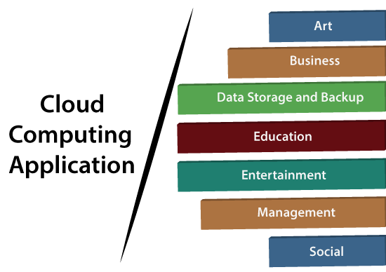

Slide 28
